Slide 1
Skills Bootcamp Classroom Rules
Be on time: Just like in a physical classroom, it's important to be punctual for your online class. Log in to the virtual classroom a few minutes before the class starts.
Turn Cameras on: In order to maximise your learning studies show that being able to see your peers and your tutor being able to see you can increase motivations and retention, therefore we ask to keep your cameras on.
Attend all classes: In order to be successful in your bootcamp studies you need to attend all live sessions, therefore you should prioritise and make time for these sessions.
Avoid distractions: Turn off your phone notifications, close any other unnecessary tabs, and focus solely on the class.
Participate actively: It's important to be an active participant in the class. Ask questions, answer questions, and participate in discussions.
Use proper language and tone: Use respectful language and tone when communicating with your classmates and instructor. Avoid using slang or inappropriate language.
Respect others' opinions: Be respectful of others' opinions, even if they differ from your own. Avoid making negative comments or attacking others.
Follow the instructor's guidelines: Follow the instructor's guidelines, such as submitting assignments on time.
Be polite: Be polite and respectful to everyone in the class, including the instructor, classmates, and guest speakers.
Dress appropriately: Even though you are not in a physical classroom, it's important to dress appropriately. Dress as if you were going to a face-to-face class.
Use appropriate technology: Ensure that you have the necessary equipment, such as a reliable internet connection, a microphone, and a webcam, and that they are in good working condition.

Slide 2
Software Developer Bootcamp
Unit 2 – Digital Processes and Services
Week 5A

Slide 3
Objectives
Following this session, you should be able to:
Identify and Explain the Core Phases in Agile Software Development Methodology
Describe the Roles and Responsibilities Associated with Each Phase
Demonstrate How to Apply Agile Phases in a Practical Scenario

Slide 4
Core Phases in Agile Software Development Methodology

Slide 5

What is Agile?
Agile is an iterative approach to project management and software development that helps teams deliver value to their customers faster and with fewer headaches.
Agile emphasizes teamwork, accountability, and iterative progress toward a well-defined goal.

Slide 6

Agile Phases
The Agile process is broken down into four distinct phases: Planning, Design, Development, and Testing.
Each phase has its own set of tasks and activities that must be completed in order to move on to the next phase.

Slide 7

Planning
The planning phase is the first step in the Agile software development methodology. It involves defining the scope and objectives of the project, as well as creating a timeline for completion.
The goal of this phase is to ensure that all stakeholders are on the same page and that the project is well-defined before any development begins.

Slide 8

Analysis
The analysis phase is the second step in the Agile software development methodology. It involves gathering requirements from stakeholders and estimating the effort required to complete the project.
The goal of this phase is to ensure that all stakeholders understand the project requirements and that the project is feasible before any development begins.

Slide 9

Design
The design phase is the third step in the Agile software development methodology. It involves creating a solution architecture that meets the project requirements.
The goal of this phase is to ensure that the project is well-designed before any development begins.

Slide 10
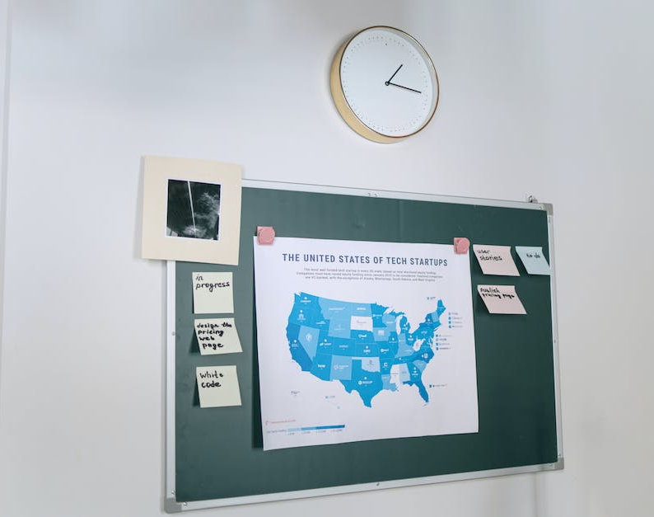
Development
The development phase is the fourth step in the Agile software development methodology. It involves building the software according to the solution architecture.
The goal of this phase is to ensure that the software is built correctly before any testing begins.

Slide 11

Testing
The testing phase is the fifth step in the Agile software development methodology. It involves verifying that the software meets the project requirements.
The goal of this phase is to ensure that the software is working correctly before any deployment begins.

Slide 12

Deployment
The deployment phase is the sixth step in the Agile software development methodology. It involves releasing the software to the intended users.
The goal of this phase is to ensure that the software is released correctly and that the users are able to use it.

Slide 13

Maintenance
The maintenance phase is the seventh step in the Agile software development methodology. It involves supporting the software after it has been released.
The goal of this phase is to ensure that the software is working correctly and that the users are able to use it.

Slide 14

Review
The review phase is the eighth step in the Agile software development methodology. It involves evaluating the process to identify areas for improvement.
The goal of this phase is to ensure that the process is efficient and effective and that the project is successful.

Slide 15

Conclusion
The Agile software development methodology is an iterative and collaborative approach to software development that is designed to be adaptive to changing requirements.
The benefits of this approach include faster delivery, better quality, and increased customer satisfaction.

Slide 16
Roles and Responsibilities Associated with Each Phase

Slide 17

Planning Phase
The planning phase is the first step in any project and is essential for the success of the project.
The project manager is responsible for defining the scope of the project, setting goals and objectives, and creating a timeline for the project.
The team should also be involved in the planning process to ensure that everyone is on the same page and understands the project goals.
The team should also be responsible for identifying any potential risks or challenges that may arise during the project.

Slide 18

Design Phase
The design phase is the second step in any project and is essential for the success of the project.
The project manager is responsible for creating the blueprint for the project, which includes the design of the project, the resources needed, and the timeline for completion.
The team should also be involved in the design process to ensure that everyone is on the same page and understands the project goals.
The team should also be responsible for identifying any potential risks or challenges that may arise during the project.

Slide 19

Implementation Phase
The implementation phase is the third step in any project and is essential for the success of the project.
The project manager is responsible for putting the plan into action, which includes assigning tasks to team members, monitoring progress, and ensuring that the project is completed on time and within budget.
The team should also be involved in the implementation process to ensure that everyone is on the same page and understands the project goals.
The team should also be responsible for identifying any potential risks or challenges that may arise during the project.

Slide 20

Testing Phase
The testing phase is the fourth step in any project and is essential for the success of the project.
The project manager is responsible for ensuring that the project meets the quality and performance standards set out in the design phase.
The team should also be involved in the testing process to ensure that everyone is on the same page and understands the project goals.
The team should also be responsible for identifying any potential risks or challenges that may arise during the project.

Slide 21

Deployment Phase
The deployment phase is the fifth step in any project and is essential for the success of the project.
The project manager is responsible for releasing the project to the public, which includes ensuring that the project is properly documented and that all necessary steps have been taken to ensure a successful launch.
The team should also be involved in the deployment process to ensure that everyone is on the same page and understands the project goals.
The team should also be responsible for identifying any potential risks or challenges that may arise during the project.

Slide 22
Maintenance Phase
The maintenance phase is the sixth step in any project and is essential for the success of the project.
The project manager is responsible for ensuring that the project is up-to-date and that any changes or updates are properly documented.
The team should also be involved in the maintenance process to ensure that everyone is on the same page and understands the project goals.
The team should also be responsible for identifying any potential risks or challenges that may arise during the project.

Slide 23

Evaluation Phase
The evaluation phase is the seventh step in any project and is essential for the success of the project.
The project manager is responsible for assessing the success of the project, which includes gathering feedback from stakeholders and team members, and analyzing the results.
The team should also be involved in the evaluation process to ensure that everyone is on the same page and understands the project goals.
The team should also be responsible for identifying any potential risks or challenges that may arise during the project.

Slide 24

Conclusion
It is essential for any project to have a clear understanding of the roles and responsibilities associated with each phase of the project.
The project manager is responsible for setting the goals and objectives, creating the timeline, and ensuring that the project is completed on time and within budget.
The team should also be involved in each phase of the project to ensure that everyone is on the same page and understands the project goals.
By understanding the roles and responsibilities associated with each phase of the project, the team can work together to ensure the success of the project.

Slide 25
How Agile is Applied in Real Life

Slide 26
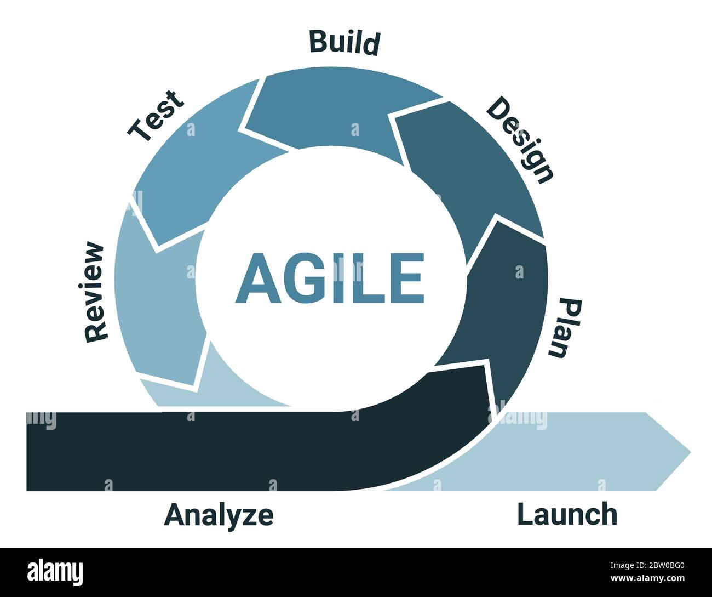
Case Study - Agile Implementation in FinTech Start-up "Bankly"
Introduction: A brief look into "Bankly," a FinTech start-up that transitioned from Waterfall to Agile.
- Requirement Gathering: User stories and backlogs replace traditional requirements documents.
- Design & Planning: Sprint planning sessions to design the architecture.
- Development & Coding: Iterative cycles or 'sprints' for development.
- Testing: Ongoing and integrated into each sprint.
- Deployment: Frequent releases and feedback incorporation.
Notes:
Good afternoon, everyone. Today, we delve into a real-world example of Agile methodology with the case study of 'Bankly,' a FinTech start-up. Bankly recently transitioned from the Waterfall model to Agile and observed a 40% increase in project efficiency. The core phases they focused on were Requirement Gathering, Design and planning, Development and coding, Testing, and Deployment. Each of these phases has its own set of activities and goals.

Slide 27
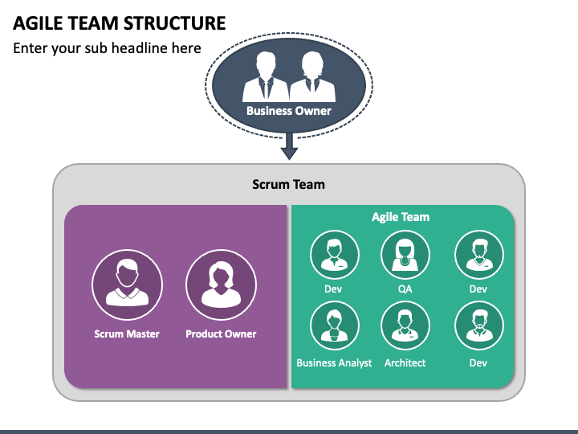
Describe the Roles and Responsibilities Associated with Each Phase
Roles and Responsibilities in Agile Phases
Who Does What in Bankly's Agile Teams?
- Product Owner: Requirement gathering and prioritisation
- Scrum Master: Sprint planning and team facilitation
- Development Team: Coding, unit testing
- QA Team: Test case design and execution
- DevOps: Continuous Integration/Continuous Deployment (CI/CD)

Slide 28
Describe the Roles and Responsibilities Associated with Each Phase
Roles and Responsibilities in Agile Phases
Who Does What in Bankly's Agile Teams?
- Product Owner: Requirement gathering and prioritisation
- Scrum Master: Sprint planning and team facilitation
- Development Team: Coding, unit testing
- QA Team: Test case design and execution
- DevOps: Continuous Integration/Continuous Deployment (CI/CD)
Notes:
In the Agile setup at Bankly, each phase is managed by specialised roles. The Product Owner leads Requirement Gathering, ensuring user stories are clear and prioritised. The Scrum Master facilitates the Design and planning phase, guiding the team through sprint planning. The Development Team takes on coding during the Development phase, and the QA Team is responsible for testing. Lastly, the DevOps team manages the Deployment phase, ensuring smooth CI/CD pipelines.

Slide 29
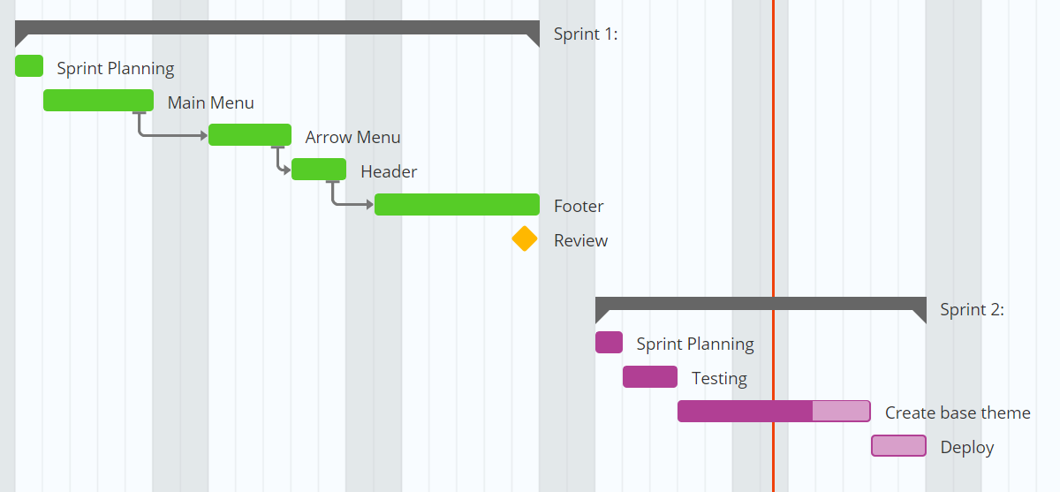
Demonstrate How to Apply Agile Phases in a Practical Scenario
Agile in Action
A Walkthrough of Bankly's Last Sprint Cycle
- Scenario: Implementation of a new payment gateway
- Requirement Gathering: User stories to cover new and existing user scenarios
- Sprint Planning: 2-week sprint, tasks allocated
- Coding & Testing: Parallel activities, daily stand-ups
- Deployment: Successful release with zero hotfixes needed
Notes:
Let's walk through how Bankly applied these Agile phases to implement a new payment gateway feature. The Product Owner gathered user stories covering new and existing user payment scenarios. The Scrum Master then facilitated a sprint planning session to allocate tasks for a 2-week sprint. During the sprint, the Development and QA Teams worked in parallel, maintaining communication through daily stand-ups. The result? A successful deployment with zero hotfixes is needed, demonstrating their Agile process's efficiency.

Slide 30
15-Minute Group Activity: "Brew Your Agile Coffee"
This activity is based on this Industry Case Study: "Cafe Agile"
Background: Cafe Agile is a small, budding coffee shop that has recently implemented Agile methodologies to manage daily operations. The case study highlights how they've adopted Agile phases such as Requirement Gathering, Planning, Development (or, in this case, "brewing"), Testing (taste tests), and Deployment (serving coffee).
Notes:
This activity will help you to Identify and Explain the Core Phases in Agile Software Development Methodology, Describe the Roles and Responsibilities Associated with Each Phase, and Demonstrate How to Apply Agile Phases in a Practical Scenario.

Slide 31
15-Minute Group Activity: "Brew Your Agile Coffee"
Phases in Cafe Agile:
1. Requirement Gathering: Employees and customers suggest new coffee flavours.
2. Planning: Decide which new coffee flavour to develop next.
3. Development: Create and brew the new coffee.
4. Testing: Conduct taste tests among staff.
5. Deployment: Serve the new coffee flavour to the customers.

Slide 32
15-Minute Group Activity: "Brew Your Agile Coffee"
Roles:
- Product Owner: The cafe manager prioritises which coffee flavour to develop.
- Scrum Master: The senior barista who coordinates and facilitates the daily stand-ups.
- Development Team: The baristas who brew the coffee.
- QA Team: Staff members who do the taste tests.
- Customers: Act as the end-users who provide feedback.

Slide 33
15-Minute Group Activity: "Brew Your Agile Coffee"
Objective: To simulate the Agile process in a fun, engaging way, focusing on the cafe setting to make it relatable for beginners.
Instructions:
Assign Roles (1 min): Each group receives cards that assign roles based on those at Cafe Agile.
Brainstorming Coffee Flavours (2 mins): Write down as many coffee flavour ideas as possible. This simulates Requirement Gathering.
Prioritise and Plan (3 mins): The Product Owner in each group chooses one flavour to 'develop.' The Scrum Master facilitates this discussion.
Feedback (2 mins): The 'coffee' is now served. Each group presents their chosen coffee flavour and brewing process to the class, simulating Deployment.

Slide 34
Selection
1
2
3
score = 20
if score > 30:
print("You won!")
You can use a logical expression in a condition to control the flow of execution in your programs.

Slide 35

Selection
1
2
3
score = 20
if score > 30:
print("You won!")
You can use a logical expression in a condition to control the flow of execution in your programs.
Here a condition has been used in a selection statement.
This is also known as an if statement.

Slide 36
Selection
1
2
3
score = 20
if score > 30:
print("You won!")
Selection statements control the flow of execution because a block of code will only run if the condition is True.

Slide 37
Selection: walkthrough
1
2
3
4
score = 20
if score > 30:
print("You won!")
print("The end")
Here is a walkthrough of a selection statement.

Slide 38
Selection: walkthrough
1
2
3
4
score = 20
if score > 30:
print("You won!")
print("The end")
score is assigned 20

Slide 39
Selection: walkthrough
1
2
3
4
score = 20
if score > 30:
print("You won!")
print("The end")
State .
score
20
score is assigned 20

Slide 40
Selection: walkthrough
1
2
3
4
score = 20
if score > 30:
print("You won!")
print("The end")
State .
False
score
20
score is not greater than 30, so the condition is False

Slide 41
Selection: walkthrough
1
2
3
4
score = 20
if score > 30:
print("You won!")
print("The end")
State .
score
20
Output .
The end
The flow of control moves to line 4 and outputs The end

Slide 42
Selection: walkthrough
1
2
3
4
score = 35
if score > 30:
print("You won!")
print("The end")
This time, score is assigned 35

Slide 43
Selection: walkthrough
1
2
3
4
score = 35
if score > 30:
print("You won!")
print("The end")
This time, score is assigned 35

Slide 44
Selection: walkthrough
1
2
3
4
score = 35
if score > 30:
print("You won!")
print("The end")
State .
score
35
This time, score is assigned 35

Slide 45
Selection: walkthrough
1
2
3
4
score = 35
if score > 30:
print("You won!")
print("The end")
State .
True
score
35
score is over 30 so this condition is now True

Slide 46
Selection: walkthrough
1
2
3
4
score = 20
if score > 30:
print("You won!")
print("The end")
State .
score
35
Output .
You won!
The flow of execution moves to line 3 and outputs You won!

Slide 47
Selection: walkthrough
1
2
3
4
score = 20
if score > 30:
print("You won!")
print("The end")
State .
score
35
Output .
You won!
The end
The flow of execution then carries on to line 4 and outputs The end

Slide 48
Objectives
Following this session, you should be able to:
Identify and Explain the Core Phases in Agile Software Development Methodology
Describe the Roles and Responsibilities Associated with Each Phase
Demonstrate How to Apply Agile Phases in a Practical Scenario

Slide 49

Questions?

Slide 50
Thank You

